Slide 1
R Clinic
Session 6:
Beginner’s visualisation in R

Slide 2
REMINDER: write down your email address for access to the Dropbox with slides and code.
We will be in this room until beginning of August.

Slide 3
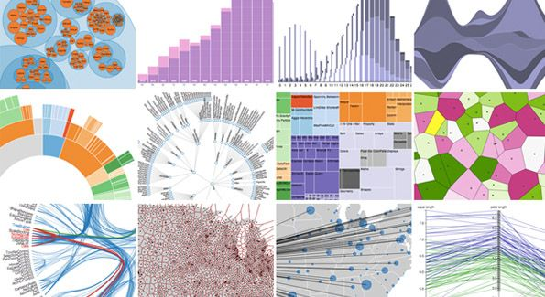
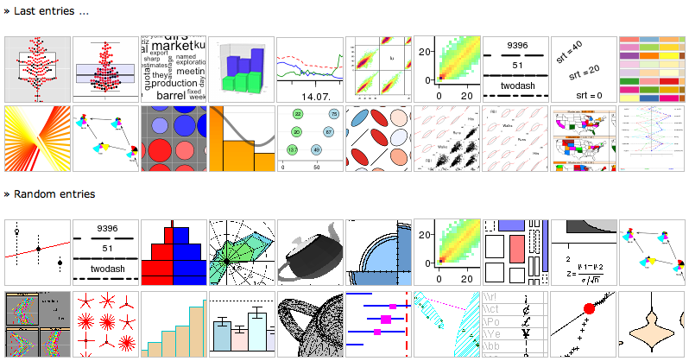
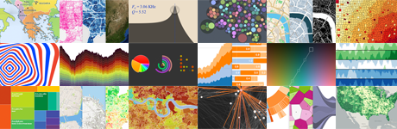
Data Visualisation
More detailed use of:
Scatter plots
Bar plots
Histograms
Density plots
Box plots
Plus:
3D plots
Output of plots
Adding images to plots

Slide 4
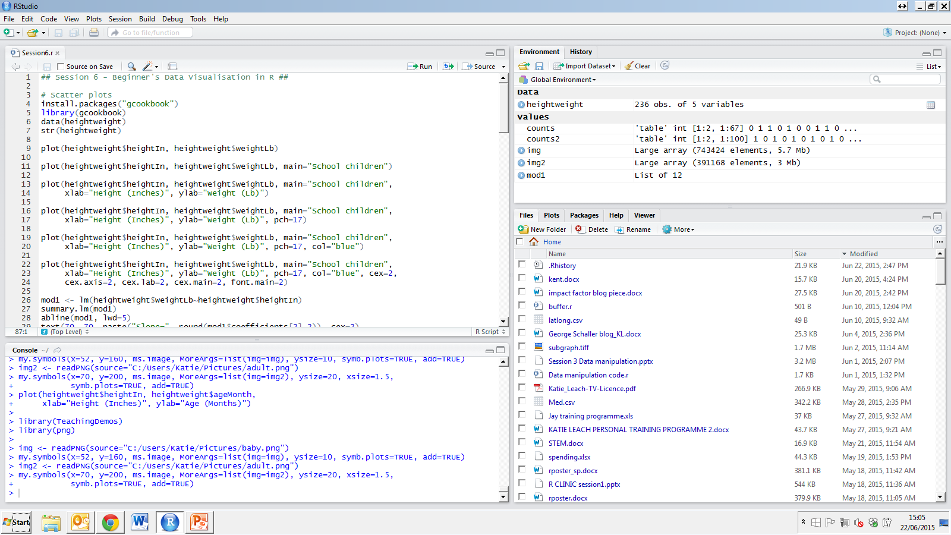
Scatter plots
Basic scatter plot
Add title
Add axes labels

Slide 5
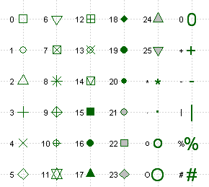
Scatter plots
Change symbol types
Change colours – see PDF in Dropbox
Change size of plot features

Slide 6
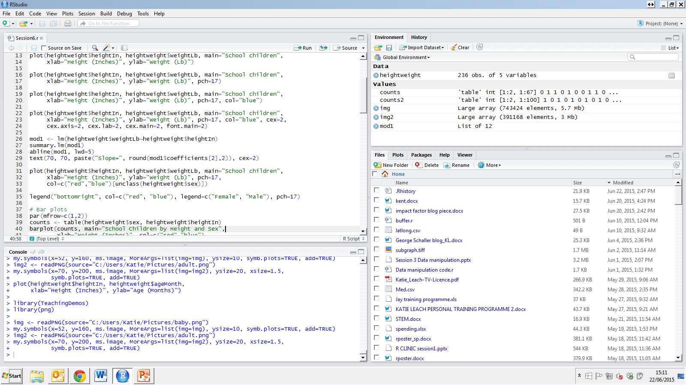
Add regression lines
Regression model
Add regression line
Add text

Slide 7
Scatter plots with factors
Plot
Add legend

Slide 8
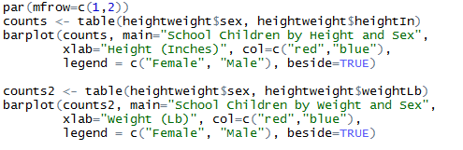
Multiple plots & Bar plots
Multiple plots – par(mfrow=c(?,?))
table = “build a contingency table of the counts at each combination of factor levels”

Slide 9
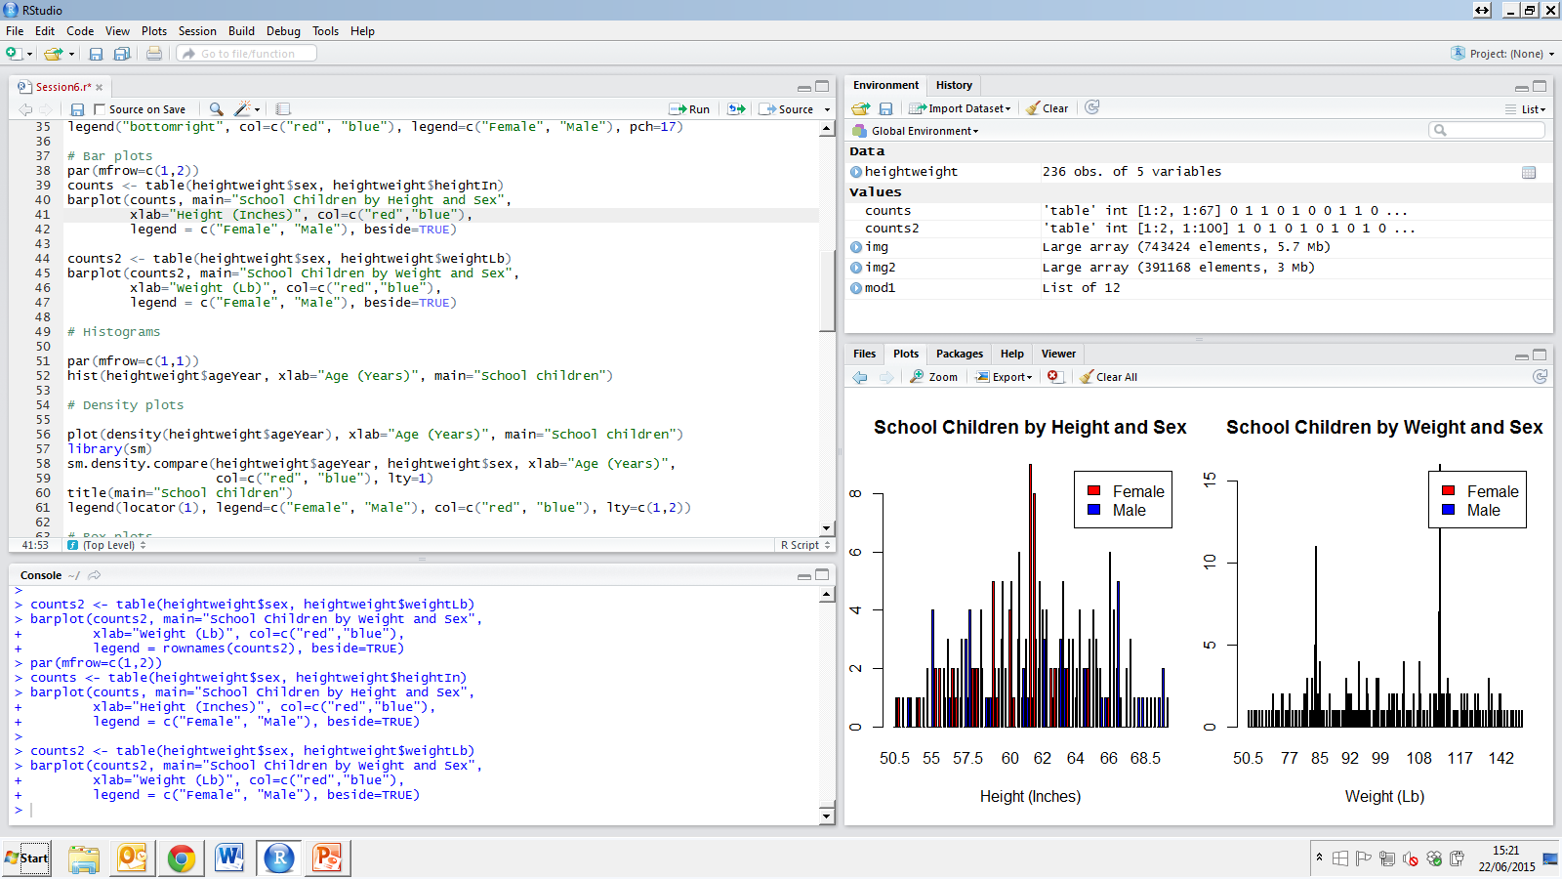
Histograms
NB. Reset to singular plot first!

Slide 10
Density plots
sm.density.compare = plot allowing comparison of multiple densities
NB. Title has to be added separately
Legends can also be added using “locator” which allows you to click in a location on the plot to place the legend
lty = line type

Slide 11
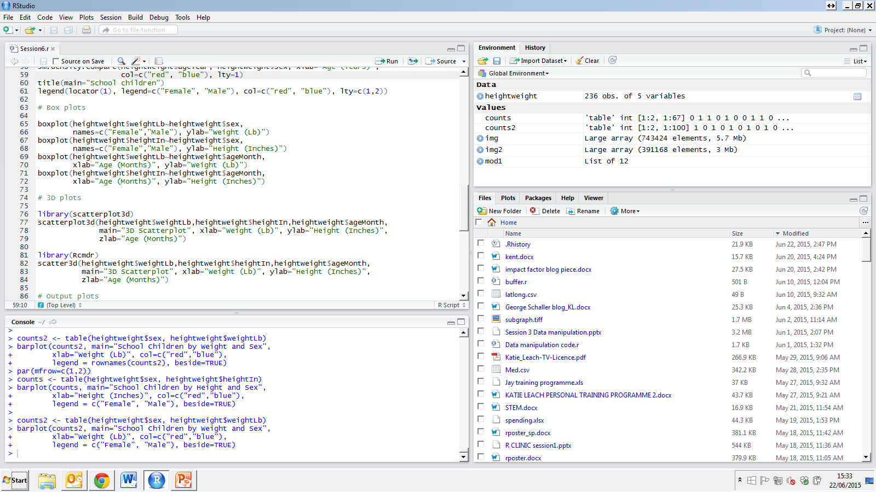
Box plots

Slide 12
3D plots
Visualise large datasets easily
Rcmdr library and scatter3d opens the plot in a new window allowing you to move the plot around!

Slide 13
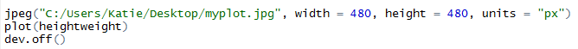
Output plots
Really useful for publications and consistency
Can use Rstudio…
Or:
NB. Units can be changed to mm or inches.
Width/height corresponds to the units
Must remember dev.off!
Can also use bmp, png, tiff, pdf, postscript() etc….

Slide 14
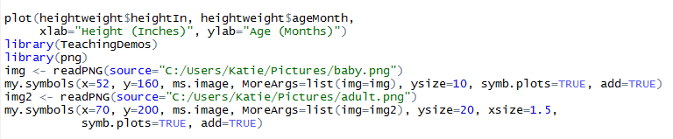
Add images to plots
Useful for presentations and sometimes publications…
Two additional packages required
Need to plot first before adding images
See ?my.symbols for more information

Slide 15
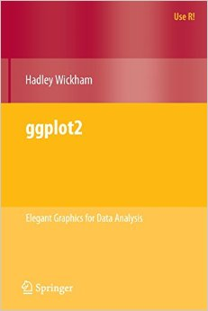
Advanced Data Visualisation
ggplot2!
Default style
Easy to display as multi-panelled plots
Aesthetics
Combine different layers easily
e.g. scatter plot + fitted smooth regression line
And…

Slide 16

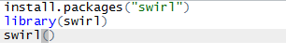
Additional resource
http://swirlstats.com/
“swirl teaches you R programming and data science interactively, at your own pace, and right in the R console!”

Slide 17

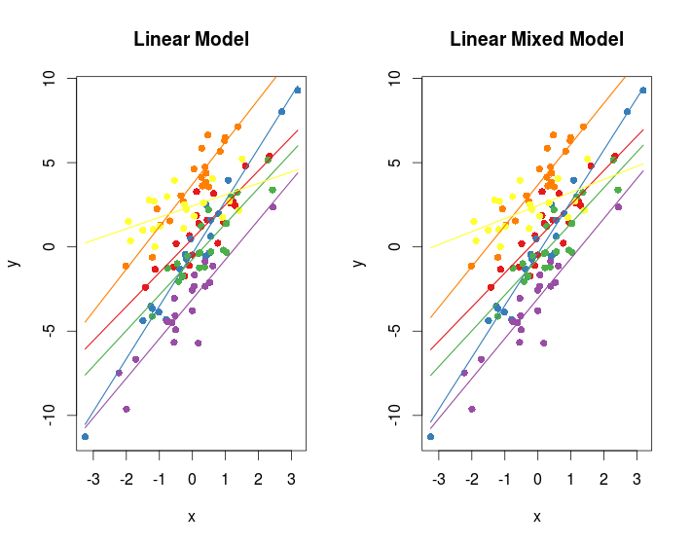
Next week…
Mixed Effects Models!

